Slide 1
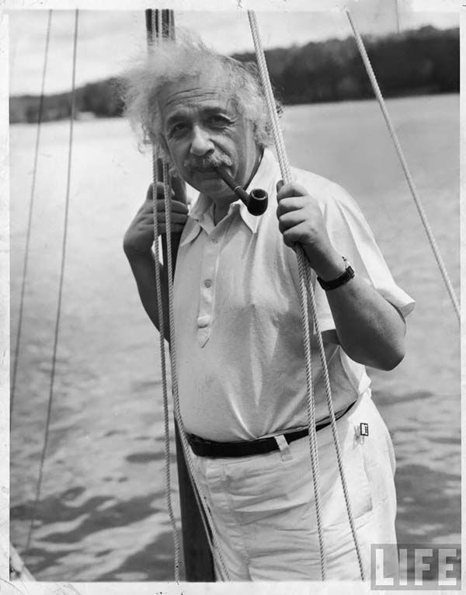
Homegrown Einsteins

Slide 2

Facts
The United States Has Produced only one homegrown Einstein since 1776.
Einstein emigrated to the U.S in 1933 after a visit, so he is not considered homegrown. (That's ok, though!)
So who is the homegrown Einstein?

Slide 3
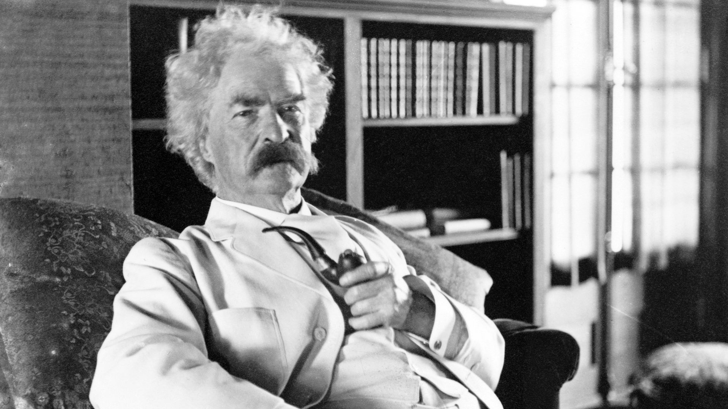
His name was Samuel Clemens

